Slide 1

Week 1: roadmap
What is the Internet?
What is a protocol?
Network edge: hosts, access network, physical media
Network core: packet/circuit switching, internet structure

Slide 2
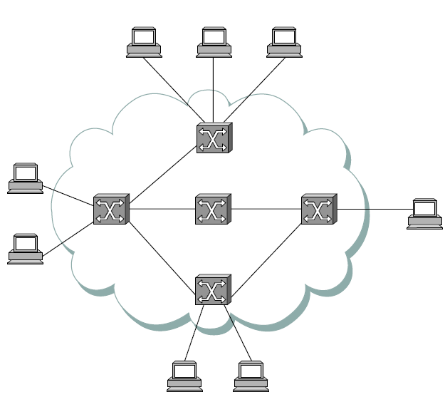
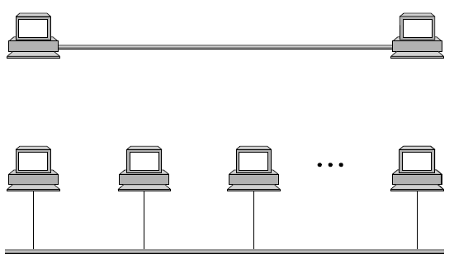
Types of Computer Networks (On the basis of Connectivity)
Direct Link Networks
Computers directly connected by guided/unguided medium\link
Point-to-Point Link
Physical links limited to a pair of nodes
Multiple-access Link
Multiple senders and receivers share one medium
Indirect Link (Switched) Networks Computers indirectly connected to each other through guided/unguided medium through specialized forwarding nodes
Point-to-Point Link
Multiple-access Link
Notes:
What is packet switching?
To send a message from a source host to a destination host, the source host breaks long application-layer messages into smaller chunks of data known as packets. Packets are forwarded from one router to the next, across links on path from source to destination. Packets are transmitted over each communication link at a rate equal to the full transmission rate or full link capacity.

Slide 3
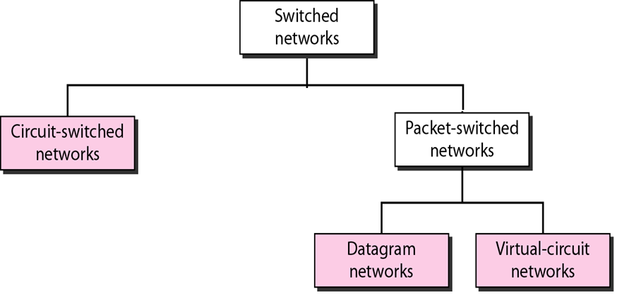
Types of Switched Networks
Forwarding nodes form Switched Networks of two types
Circuit-Switched Networks
Packet-Switched Networks
Notes:
What is packet switching?
To send a message from a source host to a destination host, the source host breaks long application-layer messages into smaller chunks of data known as packets. Packets are forwarded from one router to the next, across links on path from source to destination. Packets are transmitted over each communication link at a rate equal to the full transmission rate or full link capacity.

Slide 4
Circuit Switched Networks
Three phases involved in the communication process:
Establish the circuit
Transmit data
Terminate the circuit
Call establishment
(before data transfer)
Data transfer
Connection close
Source
Destination
Notes:
What is packet switching?
To send a message from a source host to a destination host, the source host breaks long application-layer messages into smaller chunks of data known as packets. Packets are forwarded from one router to the next, across links on path from source to destination. Packets are transmitted over each communication link at a rate equal to the full transmission rate or full link capacity.

Slide 5
Packet Switched Networks
Message is broken into discrete blocks of data (packets)
Each packet is addressed and routed separately
Packet switches use ‘store and forward’ paradigm
More suitable for data traffic (which is bursty)
Service like a post-gram (snail-mail) service unlike the telephone-like service of circuit switching
Notes:
What is packet switching?
To send a message from a source host to a destination host, the source host breaks long application-layer messages into smaller chunks of data known as packets. Packets are forwarded from one router to the next, across links on path from source to destination. Packets are transmitted over each communication link at a rate equal to the full transmission rate or full link capacity.

Slide 6
Packet Switched Networks
Packets (of same message) can take different routes
Message
1
2
Packets
Source
1
2
Destination
Notes:
What is packet switching?
To send a message from a source host to a destination host, the source host breaks long application-layer messages into smaller chunks of data known as packets. Packets are forwarded from one router to the next, across links on path from source to destination. Packets are transmitted over each communication link at a rate equal to the full transmission rate or full link capacity.

Slide 7
Packet Switched Networks
Packets (of same message) may be delivered out of order
Message
1
2
Packets
Source
1
2
Destination
Notes:
What is packet switching?
To send a message from a source host to a destination host, the source host breaks long application-layer messages into smaller chunks of data known as packets. Packets are forwarded from one router to the next, across links on path from source to destination. Packets are transmitted over each communication link at a rate equal to the full transmission rate or full link capacity.

Slide 8
Packet Switched Networks
Packets (of same message) may be delivered out of order
Message
1
2
Packets
Source
1
2
Destination
Notes:
What is packet switching?
To send a message from a source host to a destination host, the source host breaks long application-layer messages into smaller chunks of data known as packets. Packets are forwarded from one router to the next, across links on path from source to destination. Packets are transmitted over each communication link at a rate equal to the full transmission rate or full link capacity.

Slide 9
Packet Switched Networks
Few packets (of same message) may be dropped and be not delivered at all
Message
1
2
Packets
Source
1
2
Destination
Notes:
What is packet switching?
To send a message from a source host to a destination host, the source host breaks long application-layer messages into smaller chunks of data known as packets. Packets are forwarded from one router to the next, across links on path from source to destination. Packets are transmitted over each communication link at a rate equal to the full transmission rate or full link capacity.

Slide 10








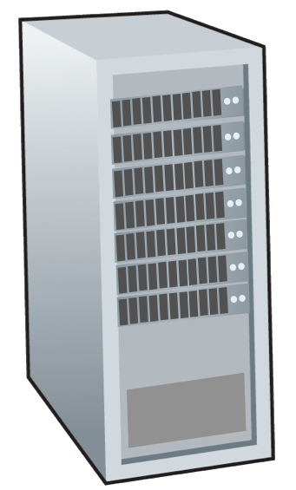







The network core
mesh of interconnected routers
packet-switching: hosts break application-layer messages into packets
forward packets from one router to the next, across links on path from source to destination
each packet transmitted at full link capacity
mobile network
national or global ISP
local or regional ISP
home network
content
provider
network
datacenter
network
enterprise
network
Notes:
What is packet switching?
To send a message from a source host to a destination host, the source host breaks long application-layer messages into smaller chunks of data known as packets. Packets are forwarded from one router to the next, across links on path from source to destination. Packets are transmitted over each communication link at a rate equal to the full transmission rate or full link capacity.

Slide 11




Packet-switching: store-and-forward
L bits
per packet
source
3
2
1
destination
R bps
R bps
Transmission delay: takes L/R seconds to transmit (push out) L-bit packet into link at R bps
Store and forward: entire packet must arrive at router before it can be transmitted on next link
End-to-end delay for one packet: 2L/R (above), assuming zero propagation delay (more on delay shortly); NL/R if there are N links each of rate R between source and destination (or there are N-1 routers)
One-hop numerical example:
L = 10 Kbits
R = 100 Mbps
one-hop transmission delay = 0.1 msec

Slide 12



Packet-switching: store-and-forward
3 packets;
L bits per packet
Source
3
2
1
R bps
R bps
Destination
Can you calculate the delay for receiving all 3 Packets at the destination?
 | Source Transmit start time | Router Store & forward time | Destination Receive time
Packet 1 | 0 | L/R | 2L/R
Packet 2 | L/R | 2L/R | 3L/R
Packet 3 | 2L/R | 3L/R | 4L/R
Notes:
The transmission delay is the time that it takes to push out the packet. It depends on the packet length and the link capacity or what is called transmission rate.
Here we will ignore propagation delay—the time it takes for the bits to travel across the wire at near the speed of light.
We also ignore the processing delay-the time that the router takes to process the packets.

Slide 13
Packet-switching: Question
p packets;
L bits per packet
Source
3
2
1
Destination
R bps
R bps
Can you calculate the delay for receiving all p Packets sent over a series of N links at the destination?
Some useful hints:
The end-to-end delay for one packet sent over a path of N links each of rate R is NL/R
The source and routers will start to push out next packet once they finish sending the entire last packet
Try to expand and use the table given in the last slide which may be helpful
Once you calculate an expression, test it by assigning some values to p and N

Slide 14
Packet-switching: Question
p packets;
L bits per packet
Source
3
2
1
Destination
R bps
R bps
Can you calculate the delay for receiving all p Packets sent over a series of N links at the destination?
Answer: (N+p-1)L/R
Notes:
===========
Here we will ignore propagation delay—the time it takes for the bits to travel across the wire at near the speed of light.

Slide 15
Packet-switching: queueing delay, loss
R = 100 Mb/s
C
A
R = 15 Mb/s
D
B
E
queue of packets
waiting for output link
Packet queuing and loss: if arrival rate (in bps) to link exceeds transmission rate (bps) of link for a period of time:
packets will queue, waiting to be transmitted on output link
packets can be dropped (lost) if memory (buffer) in router fills up
Notes:
For each output link, the packet switch has an output buffer (or output queue), which stores packets that the router is about to send into that link.

Slide 16
Two key network-core functions
routing algorithm
Routing:
global action: determine source-destination paths taken by packets
routing algorithms
routing algorithm
Forwarding:
local action: move arriving packets from router’s input link to appropriate router output link
local forwarding table
local forwarding table
header value
output link
0100
0101
0111
1001
3
2
2
1
1
3
2
0111
destination address in arriving
packet’s header

Slide 17
Alternative to packet switching: circuit switching
2nd circuit
end-to-end resources allocated to, reserved for “call” between source and destination
establish a connection between source and destination before transmission
connection: called “circuit” (virtual)
dedicated resources: no sharing
circuit-like (guaranteed) performance
circuit segment idle if not used by call (no sharing)
commonly used in traditional telephone networks
4 virtual “circuits”
1st circuit
A simple circuit-switched network:
in diagram, each link has four circuits.
call gets 2nd circuit in top link and 1st circuit in right link.
Notes:
In circuit-switched networks, the end-to-end resources are reserved for transmission between source and destination for the duration of that transmission session.
In the right figure, because each link has four circuits, the connection using one circuit gets one fourth of the link’s total transmission capacity. For example, if each link has a transmission rate of 1 Mega bits per second, then each end-to-end connection gets 250 kilo bits per second of dedicated transmission rate.
In packet-switched networks, the resources are not reserved. The transmitted messages use the resources on demand and, sometimes need to wait (that is, queue) for access to a communication link.

Slide 18
Circuit switching: FDM and TDM
Frequency Division Multiplexing (FDM)
optical, electromagnetic frequencies divided into (narrow) frequency bands
each circuit allocated its own band, can transmit at max rate of that narrow band
4 users
frequency
time
Time Division Multiplexing (TDM)
time divided into frames of fixed duration where one frame contains a fixed number of time slots
each circuit assigned periodic slot(s), can transmit at maximum rate of (wider) frequency band, but only during its time slot(s)
frequency
time

Slide 19
Circuit switching: an example
Example scenario:
transfer a file from Host A → B with a file size of 640,000 bits
through a circuit-switched network in which each link has 24 circuits
each link has a transmission rate of 1.536 Mbps
circuit establishment time before Host A can start transmission is 500 ms
Question:
How long does it take to send a file of 640,000 bits from Host A to Host B over the given circuit-switched network (with circuit establishment time also considered)?
Some useful hints:
The transmission rate of each circuit needs to be calculated.
The network needs to first establish a connection between host A and B before transmission starts.

